Slide 1
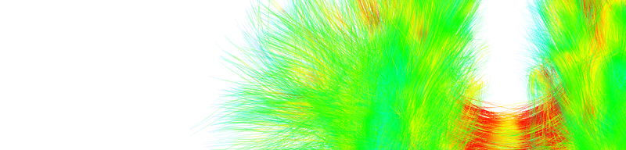
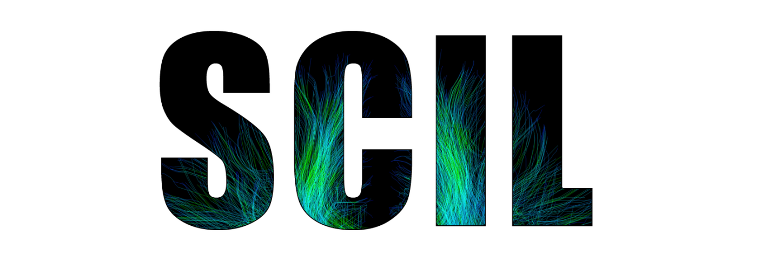


Diffusion
Tractography
Eleftherios Garyfallidis, Ph.D.
Diffusion Imaging in Python
http://dipy.org
Sherbrooke Connectivity Imaging
Laboratory (SCIL)
http://scil.dinf.usherbrooke.ca
Notes:
Merci Gilles Kahn

Slide 2
Basic principles

Slide 3
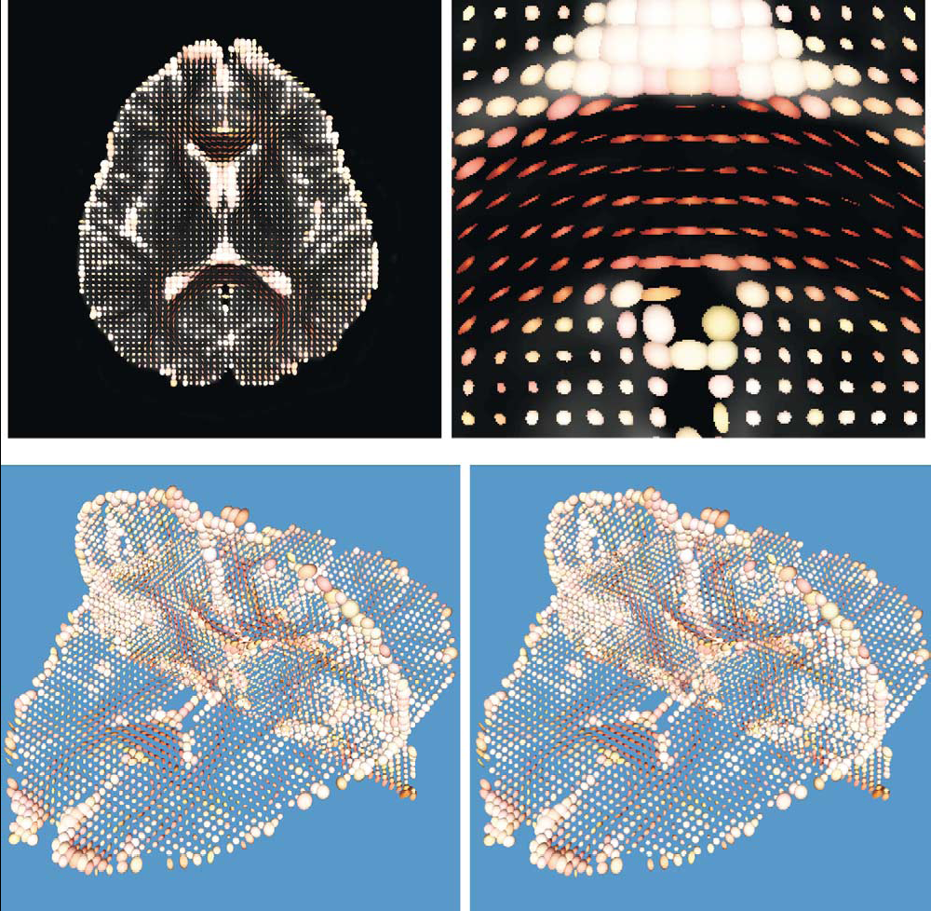
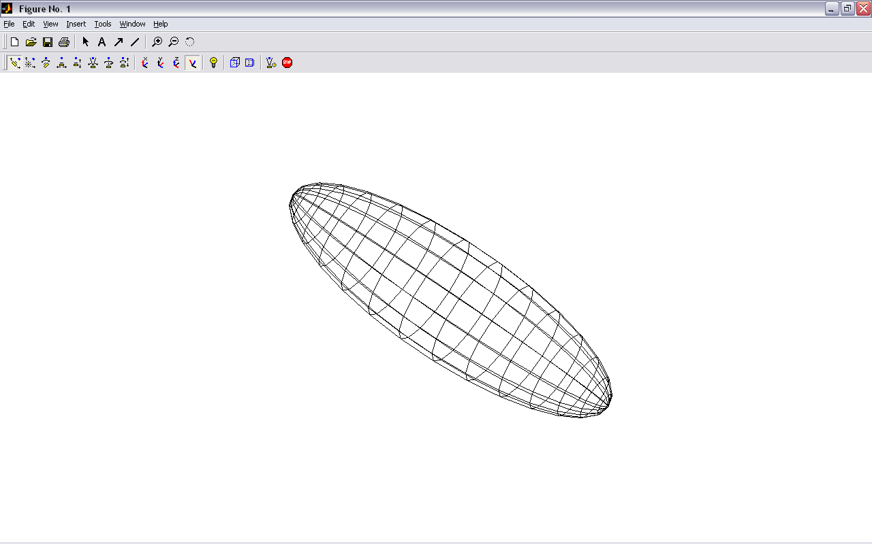
Main idea: Tensor-based tracking
z
v₁
λ₁
v₂
v₃
x
Y.Masutani et al.” European Journal of Radiology 46 (2003)

Slide 4
Connect the main directions voxel to voxel
z
v₁
λ₁
v₂
v₃
x

Slide 5
Deterministic tracking
If we assume the main eigenvector is tangential to the underlying trajectory of the white matter
Starting from a seed point we can propagate a 3D curve that represents the WM pathway
v₁
Two main approaches :
FACT - (Mori et al 1999)
Interpolated Streamlines (Euler, RK, etc) - (Basser et al. 2000)
Streamline Tractography
Seed Point

Slide 6
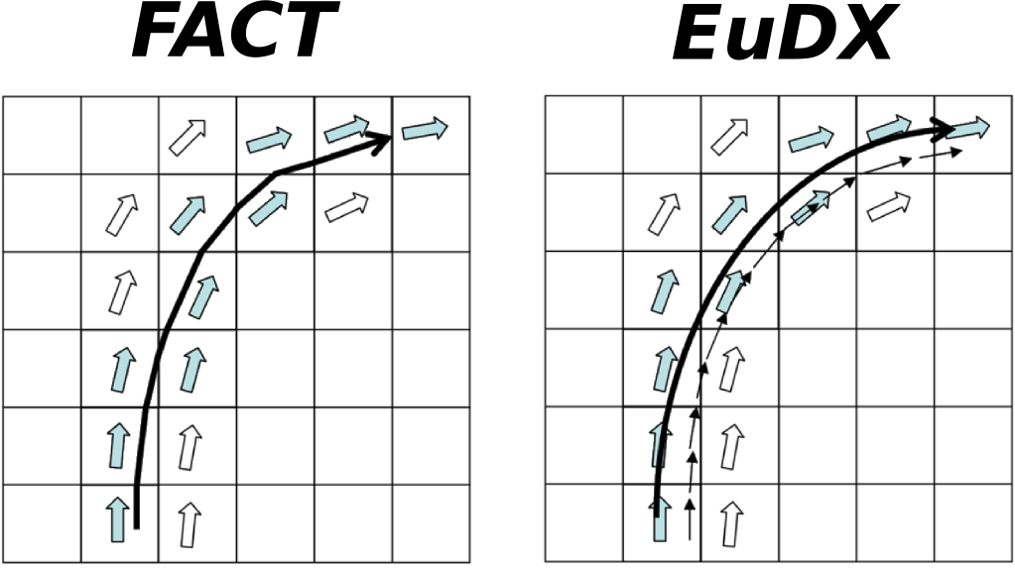

Deterministic tracking
FACT Interpolated
The track follows a path parallel to the principal eigenvector until the border of the voxel.
The step size is not fixed
Works well with low curvature regions
FACT is used in DTI-Studio and TrackVis
At each step a new direction is interpolated taking into account the surrounding eigenvectors
Step size is fixed
Available in Dipy (Garyfallidis, Frontiers 2014)
New Position
Old Position
Step Size
Principal Eigenvector
= + x
E

Slide 7
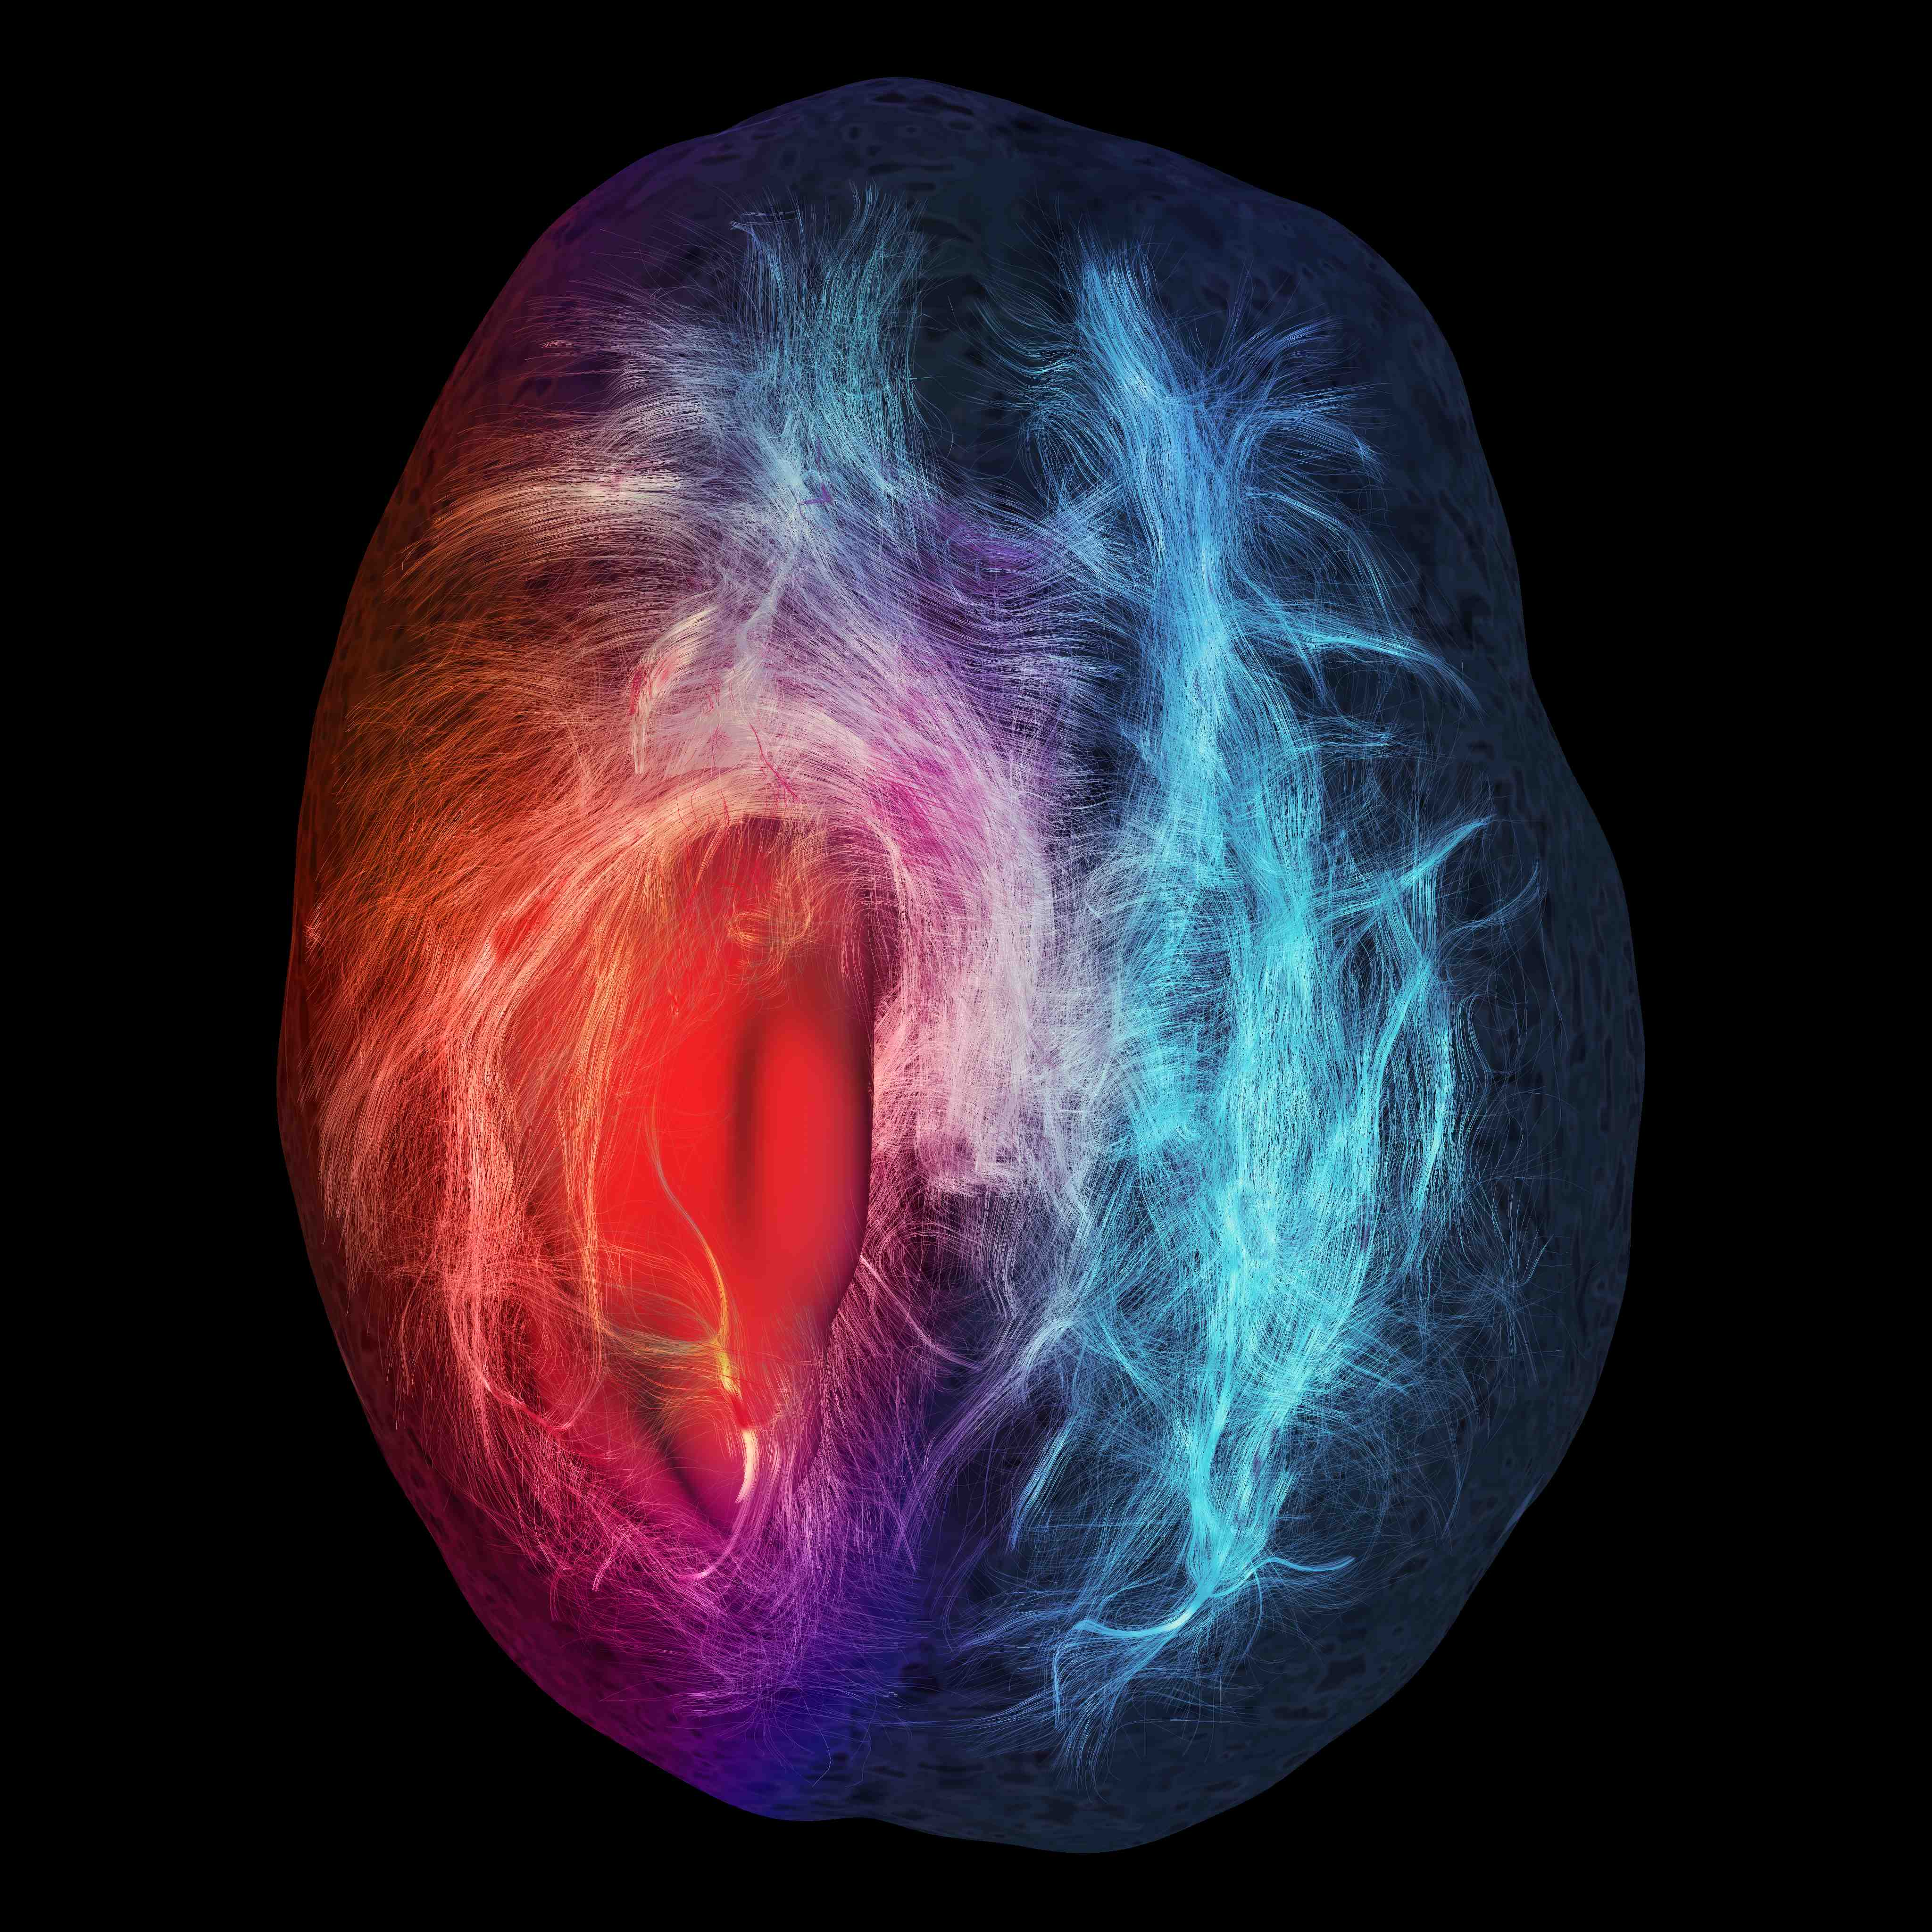
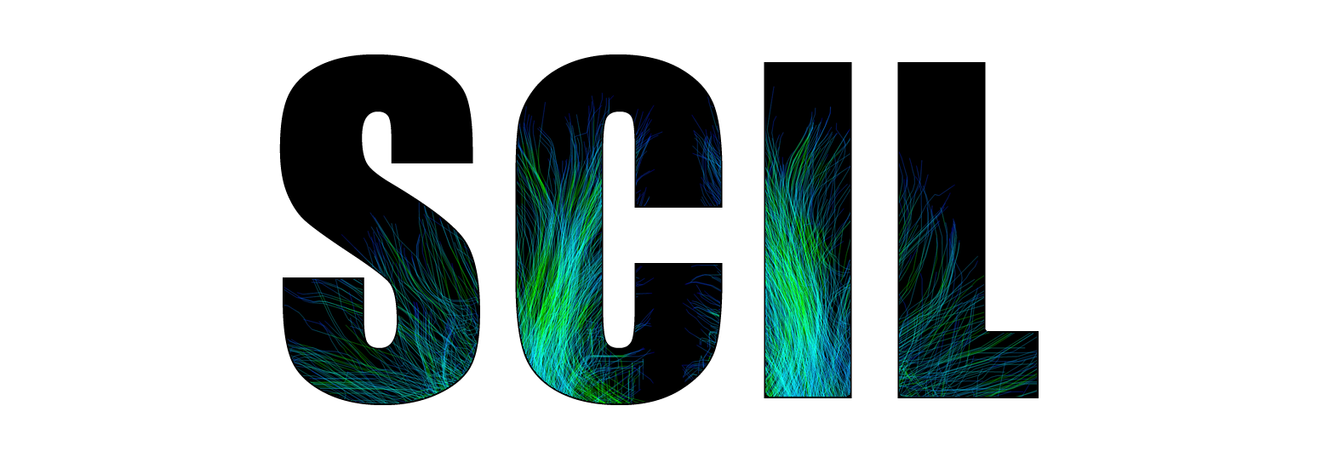
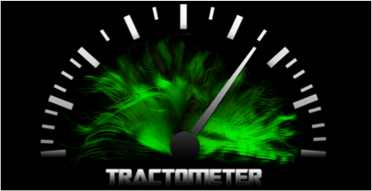

Thank you
http://scil.dinf.usherbrooke.ca
http://tractometer.org

